Slide 1
48024 Applications Programming
Dr Angela Huo

Slide 2
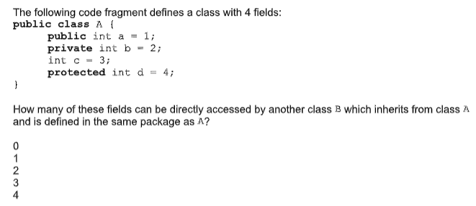
Quiz

Slide 3
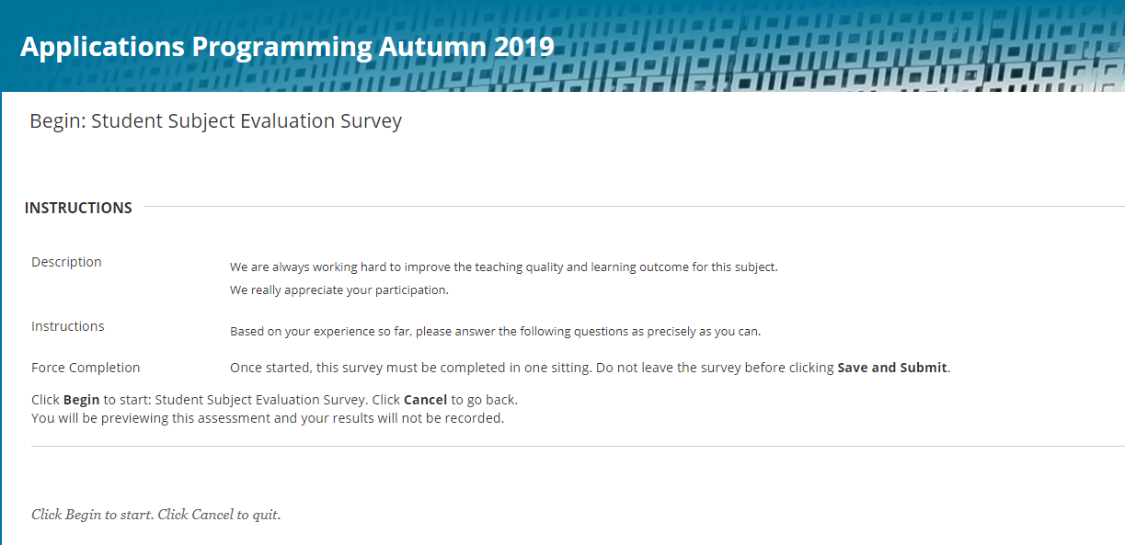
UTSOnline Survey
The UTSOnline Survey is now open for student feedback.

Slide 4
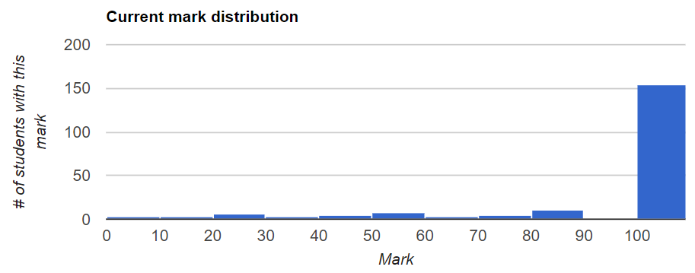
Lab 5 Review

Slide 5
Adding cash to the cash register
Product
Sell()
Input:# of stock
Output: T_price
Action:stock--
CashRegister
Sell()
Input: T_price
Output: void
Action:cash++
Store
Sell(){
Product.sell();
Cash.sell();
}
T_price
# of Stock

Slide 6
Lab 6
30 min Intro + Demo
10 min analysis
Remaining time -- Coding
NOTE: This Friday lab is arranged on 26th April!!!
Lab 6 is critical preparation for the assignment.
Next lab before StuVac will offer assignment support. Bring along your code!!!
(Last opportunity for face-to-face support before the due date!)

Slide 7

Contact
Subject Coordinator and Lecturer: Angela Huo
Email: huan.huo@uts.edu.au
Contact information on UTSOnline

